Slide 1
Elliptic Curve Cryptography: finite fields and discrete logarithms
분산네트워크연구실 32731 김희주

Slide 2

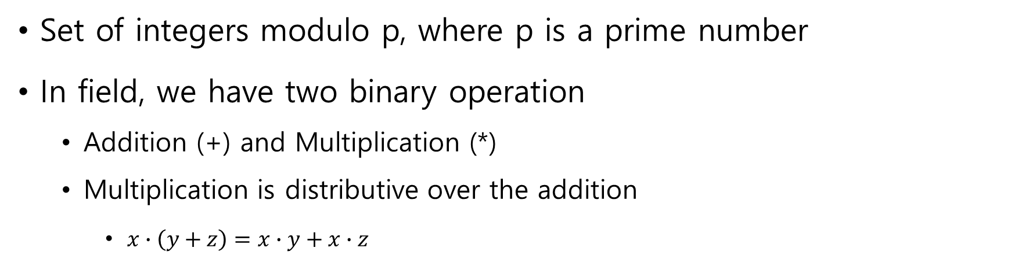

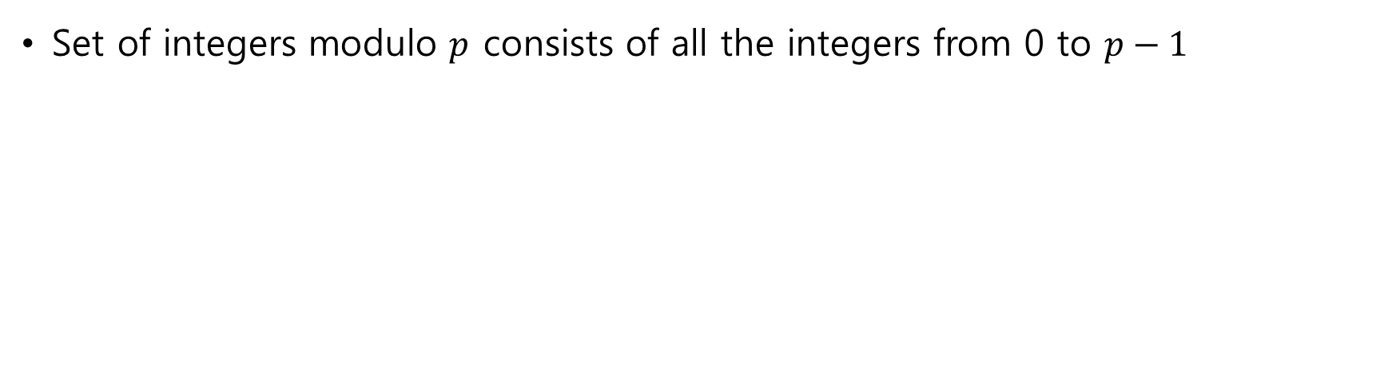
The field of integers modulo $p$
Set of integers modulo p, where p is a prime number
In field, we have two binary operation
Addition (+) and Multiplication (*)
Multiplication is distributive over the addition
$x∙\left(y+z\right)=x∙y+x∙z$
Set of integers modulo $p$ consists of all the integers from 0 to $p−1$

Slide 3
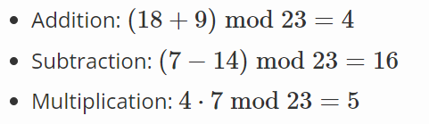
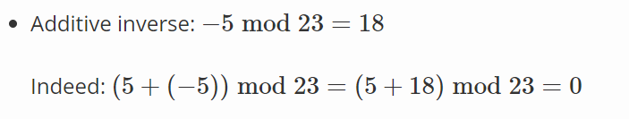
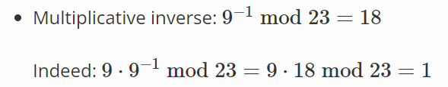
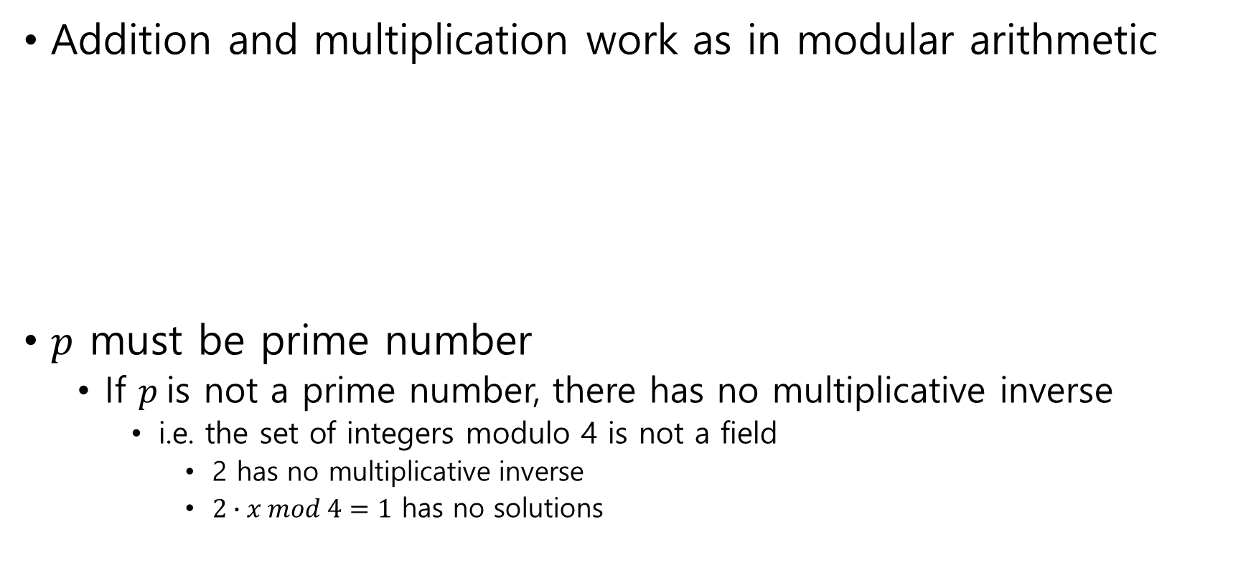
The field of integers modulo $p$
Addition and multiplication work as in modular arithmetic
$p$ must be prime number
If $p$is not a prime number, there has no multiplicative inverse
i.e. the set of integers modulo 4 is not a field
2 has no multiplicative inverse
$2∙x mod 4=1$ has no solutions

Slide 4
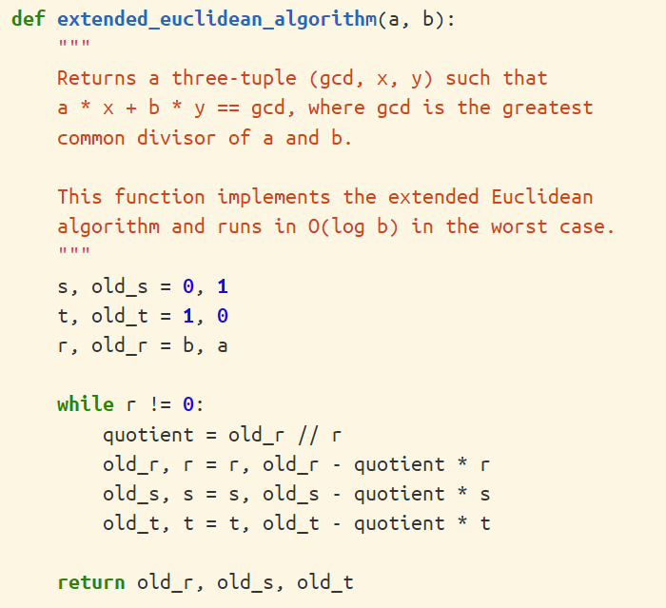
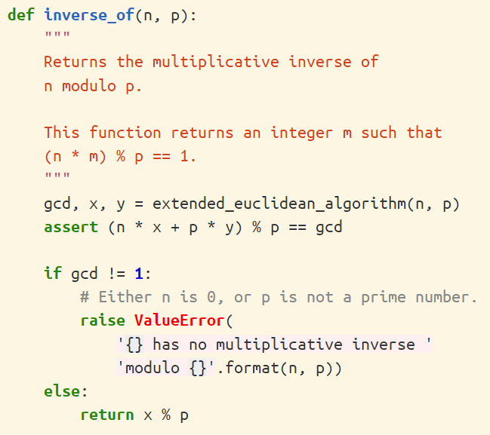
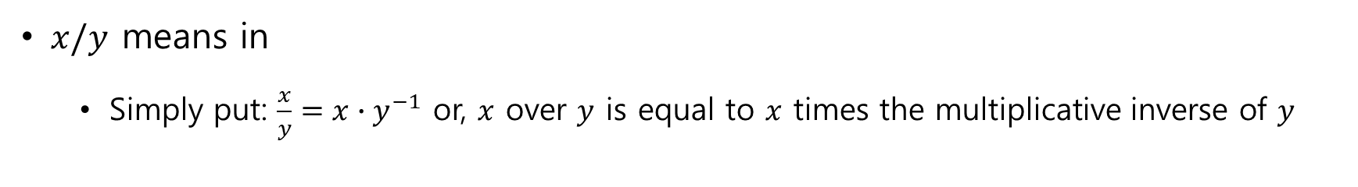
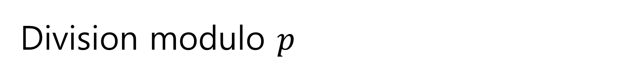
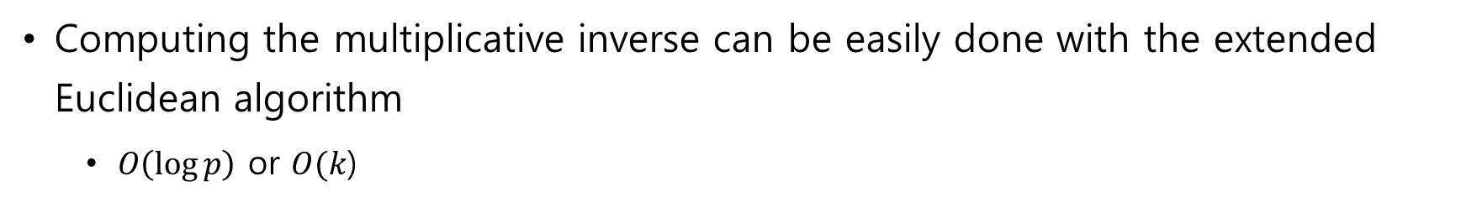
Division modulo $p$
$x/y$ means in
Simply put: $\frac{x}{y}=x∙y^{−1}$ or, $x$ over $y$ is equal to $x$ times the multiplicative inverse of $y$
Computing the multiplicative inverse can be easily done with the extended Euclidean algorithm
$O\left(\log{p}\right)$ or $O(k$)

Slide 5
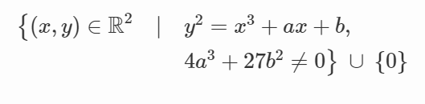
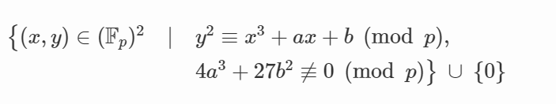

Elliptic curves in
Previous version
\
version
Where 0 is still the point at infinity, and $a$ and $b$ are two integers in

Slide 6
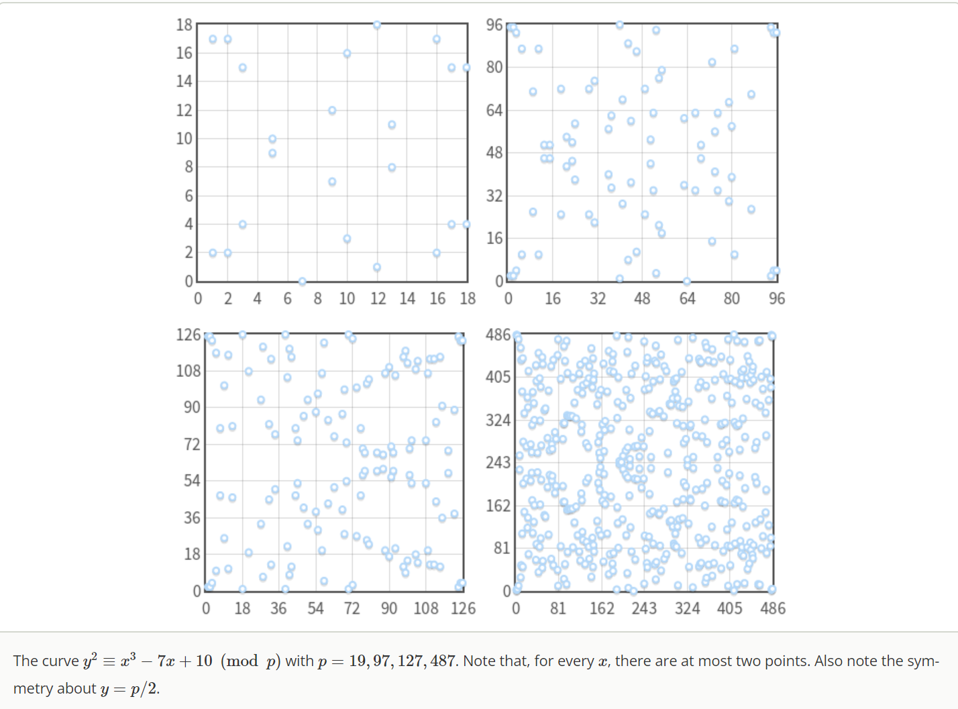
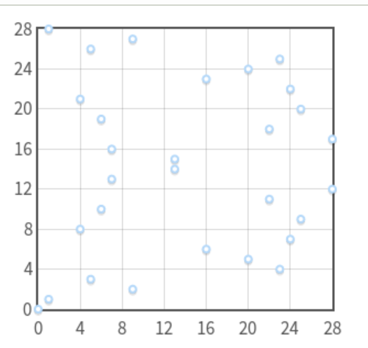
Elliptic curves in

Slide 7
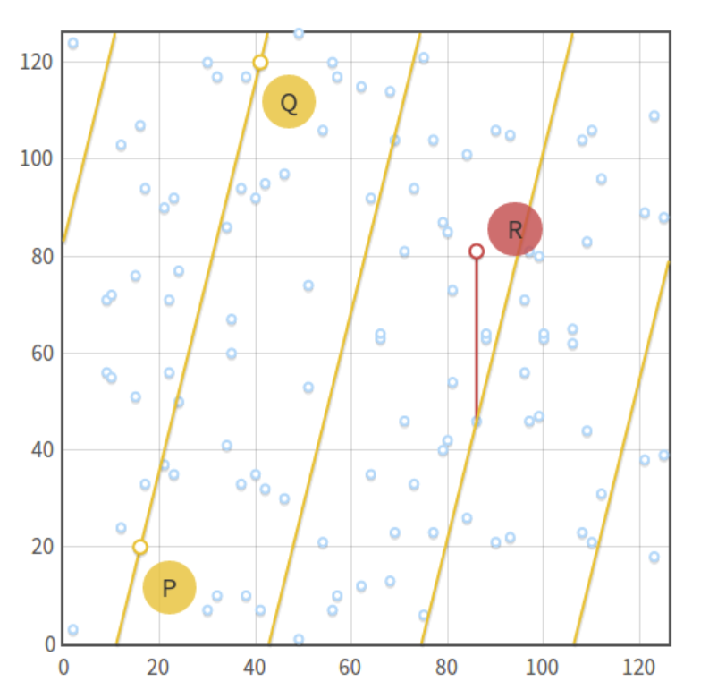
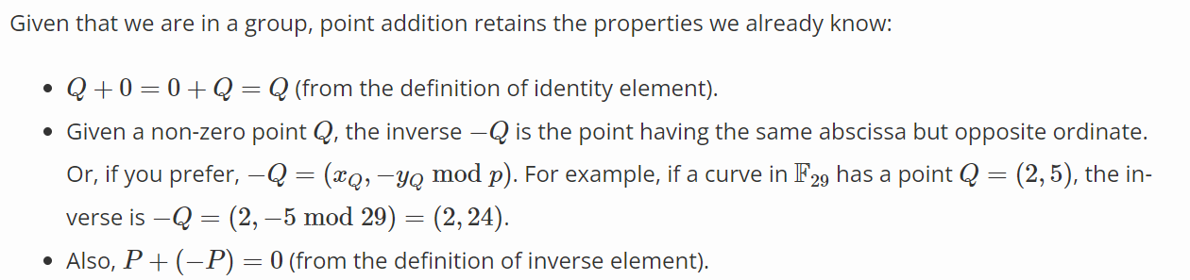
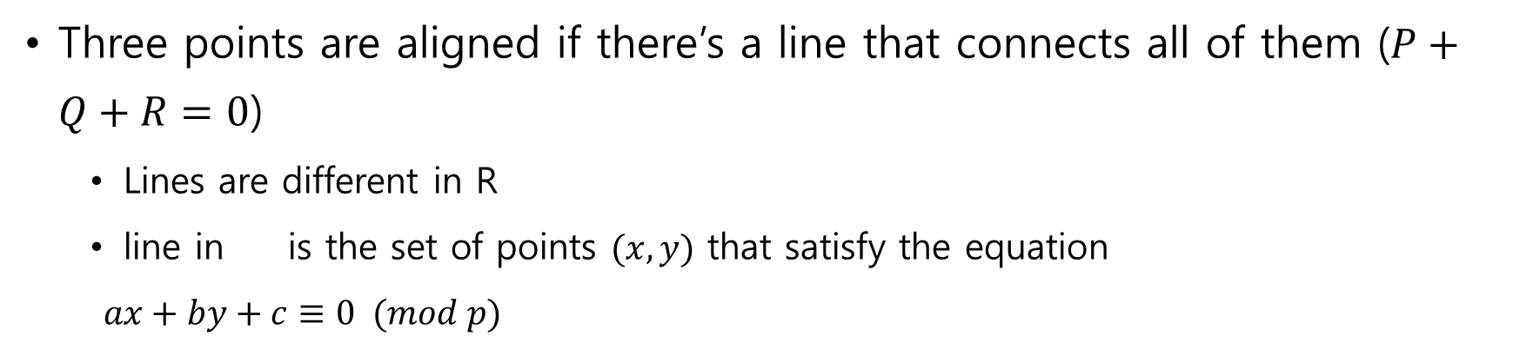
Point addition in
Three points are aligned if there’s a line that connects all of them ($P+Q+R=0$)
Lines are different in R
line in is the set of points $(x, y)$ that satisfy the equation
$ax+by+c≡0 (mod p)$

Slide 8
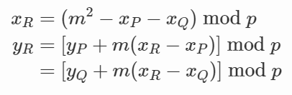
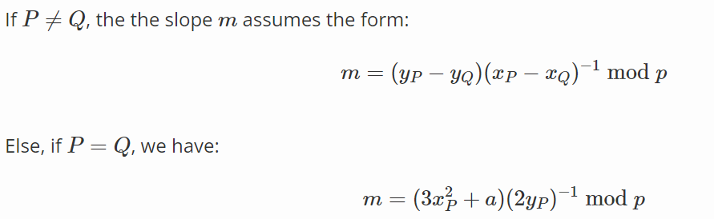
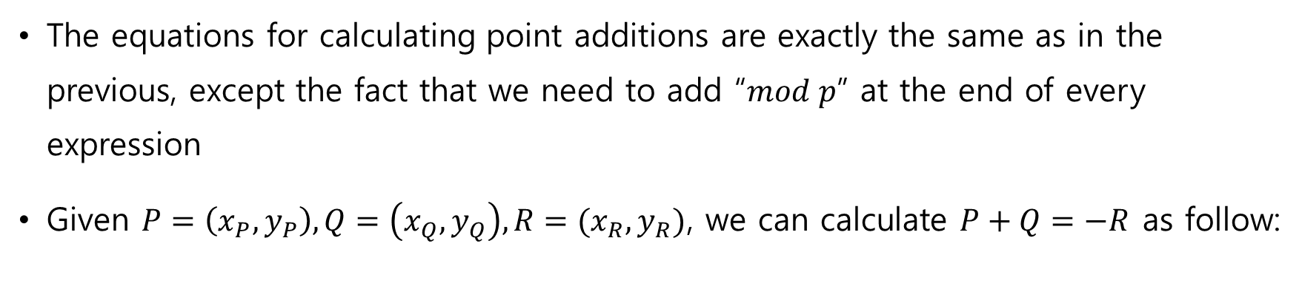
Algebraic sum
The equations for calculating point additions are exactly the same as in the previous, except the fact that we need to add “$mod p$” at the end of every expression
Given $P=\left(x_{P}, y_{P}\right), Q=\left(x_{Q}, y_{Q}\right), R=(x_{R}, y_{R})$, we can calculate $P+Q=−R$ as follow:

Slide 9
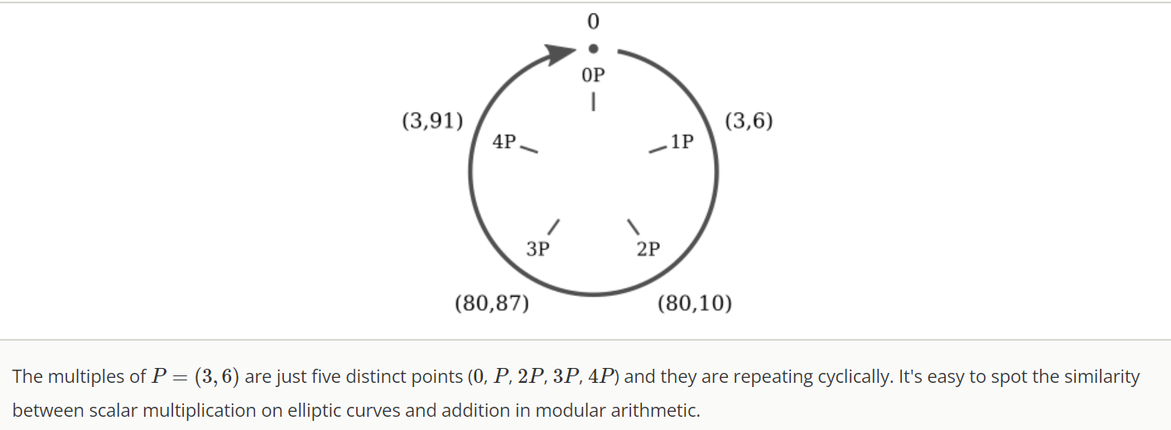
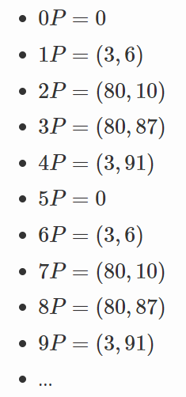
Scalar multiplication and cyclic subgroups

Slide 10
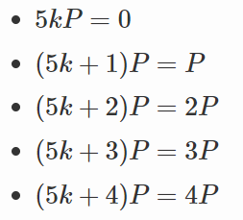
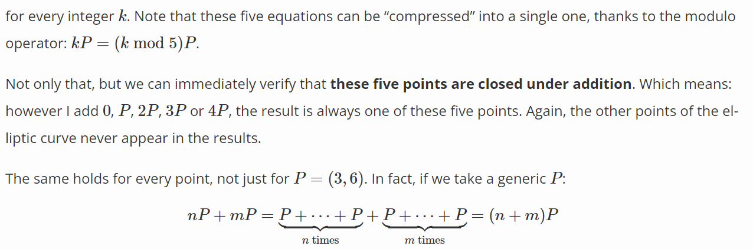
Scalar multiplication and cyclic subgroups

Slide 11

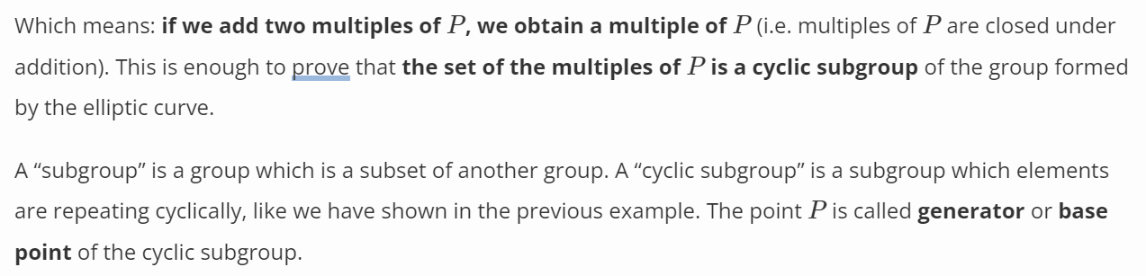
Scalar multiplication and cyclic subgroups

Slide 12
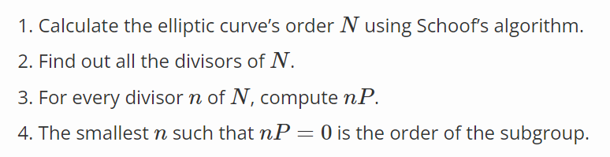
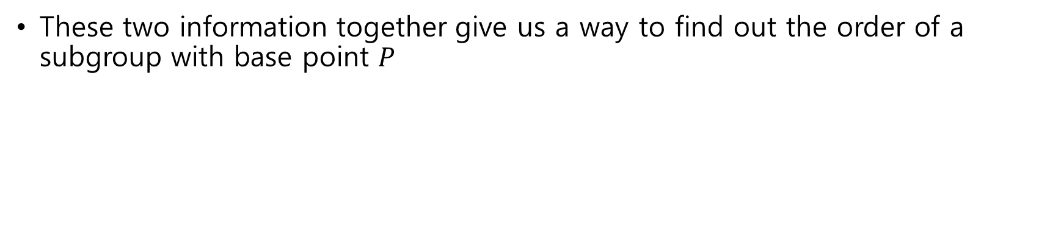
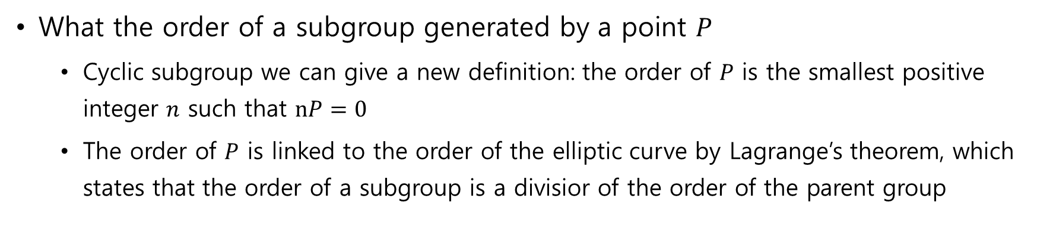
Subgroup order
What the order of a subgroup generated by a point $P$
Cyclic subgroup we can give a new definition: the order of $P$ is the smallest positive integer $n$ such that $nP=0$
The order of $P$ is linked to the order of the elliptic curve by Lagrange’s theorem, which states that the order of a subgroup is a divisior of the order of the parent group
These two information together give us a way to find out the order of a subgroup with base point $P$

